Slide 1
How to Estimate Body Fat Percentage
Group 8
An Analytical Study on flight Data
Members: Meiyi Yan, Minyuan Zhao, Siyu Wang

Slide 2
01
Introduction

Slide 3
01 Introduction
Goal
The holiday season (Nov. 1st to Jan 31st) is one of the busiest times for the airline industry. We try to help passengers mitigate potential delays and cancellations.
Data Set
Our study focuses on all domestic flights in the United States during the Holiday season (from Nov. 1st to Jan. 31st) from 2018 to 2024.
We combined historical flight data from the U.S. Department of Transportation with historical weather data from the National Centers for Environmental Information, retrieving climate data via API.

Slide 4
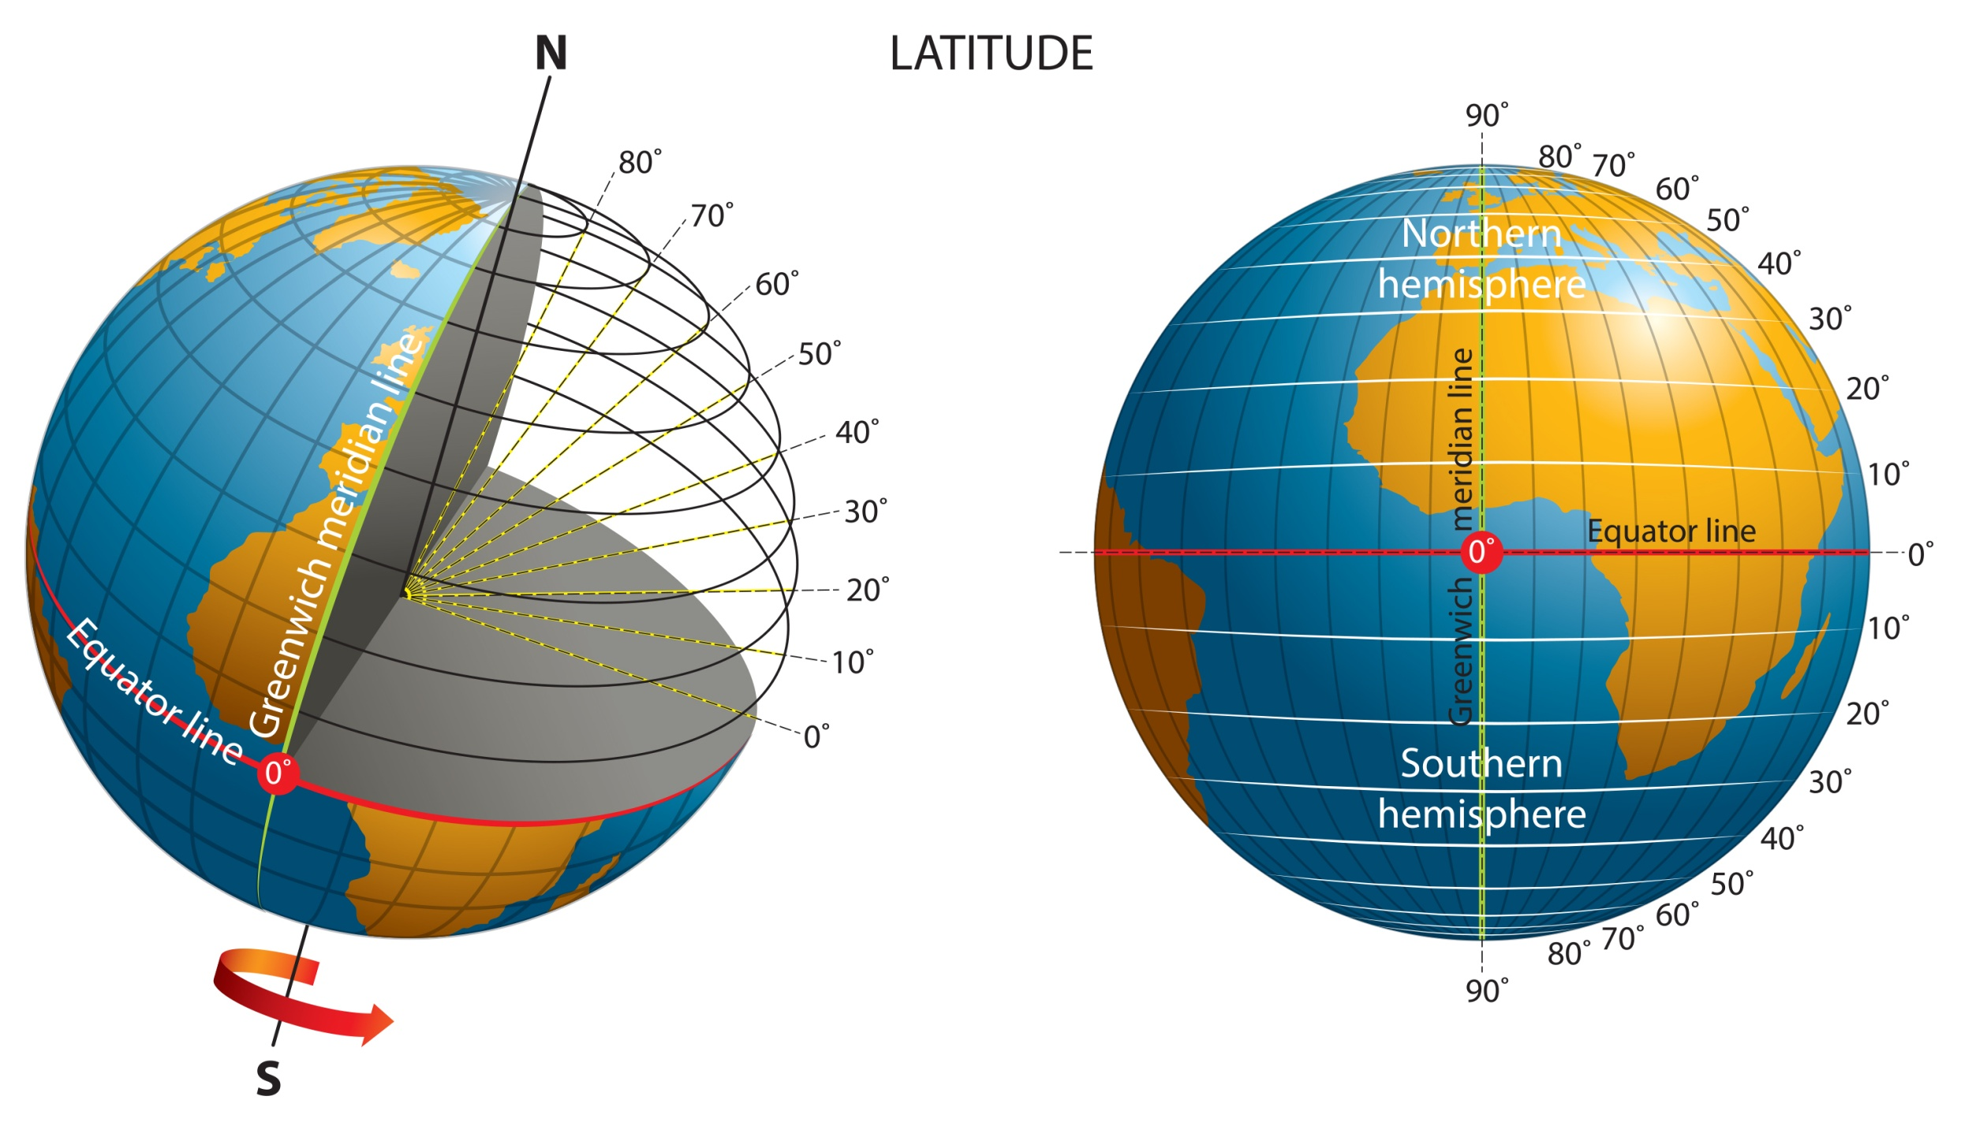
01 Introduction
Data Merge
Match airports with weather stations:
Each airport is matched with its nearest weather station based on location by using geopy package;
If data from that station is unavailable, we proceed to the next closest station, continuing this process as needed.
Match Time:
Convert Time Zone.
Match the weather conditions of the corresponding weather station based on the departure and arrival time of flights.

Slide 5
02
Prep and EDA

Slide 6
02 Data Cleaning
1 Remove irrelevant columns and features
Remove irrelevant columns and features with over 70% missing values; ensure all remaining columns have less than 25% missing values.
2 Impute missing values
a) Use mean for Arrival_HourlySeaLevelPressure, Departure_HourlySeaLevelPressure, Arrival_HourlyStationPressure and Departure_HourlyStationPressure.
b) Use median for Arrival_HourlyVisibility and Departure_HourlyVisibility.
c) Use 0 for missing values and “T” in Arrival_HourlyPrecipitation and Departure_HourlyPrecipitation.
d) Replace "VRB" in Arrival_HourlyWindDirection and Departure_HourlyWindDirection with 999.0.

Slide 7
02 Data Cleaning
3 Convert data
a) Apply one-hot encoding to Arrival_HourlySkyConditions, Departure_HourlySkyConditions and airline.
b)The departure and arrival airports into numeric encodings.
c) Perform time binning: 5 AM to 12 PM as "morning," 12 PM to PM as "afternoon," 5 PM to 9 PM as "evening," and other times as "night."
e) Convert the time column to a Unix timestamp for calculating.
Delete samples with missing values and outliers.
There are a total of 7112271 records and 26 features.

Slide 8
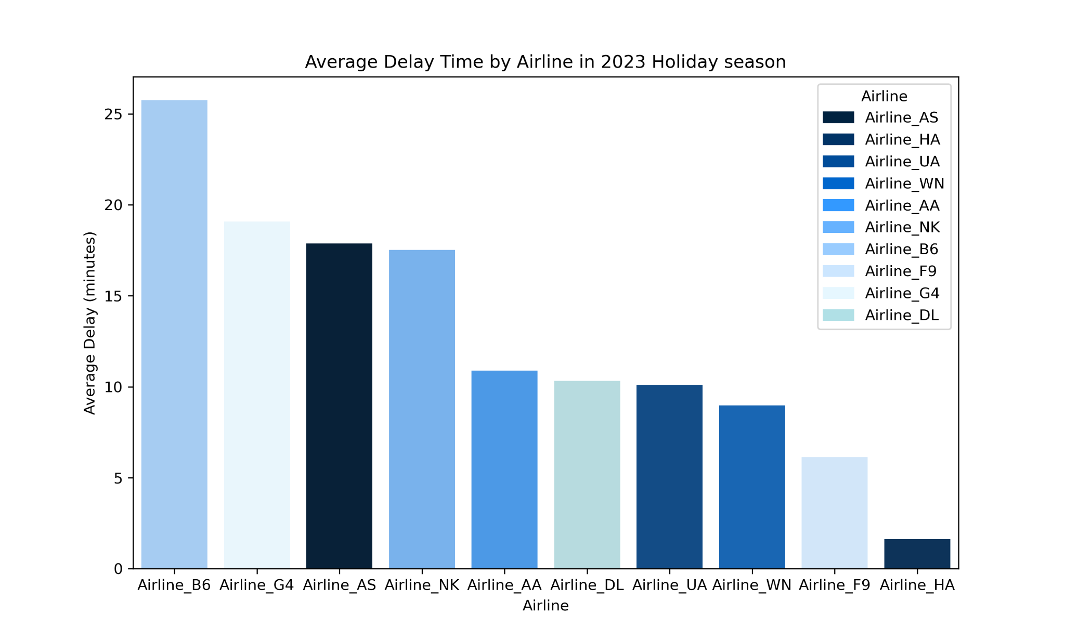
02 Data Cleaning
There are significant differences in cancellation rates and average delay times across various airlines. So we apply one-hot encoding to airlines

Slide 9
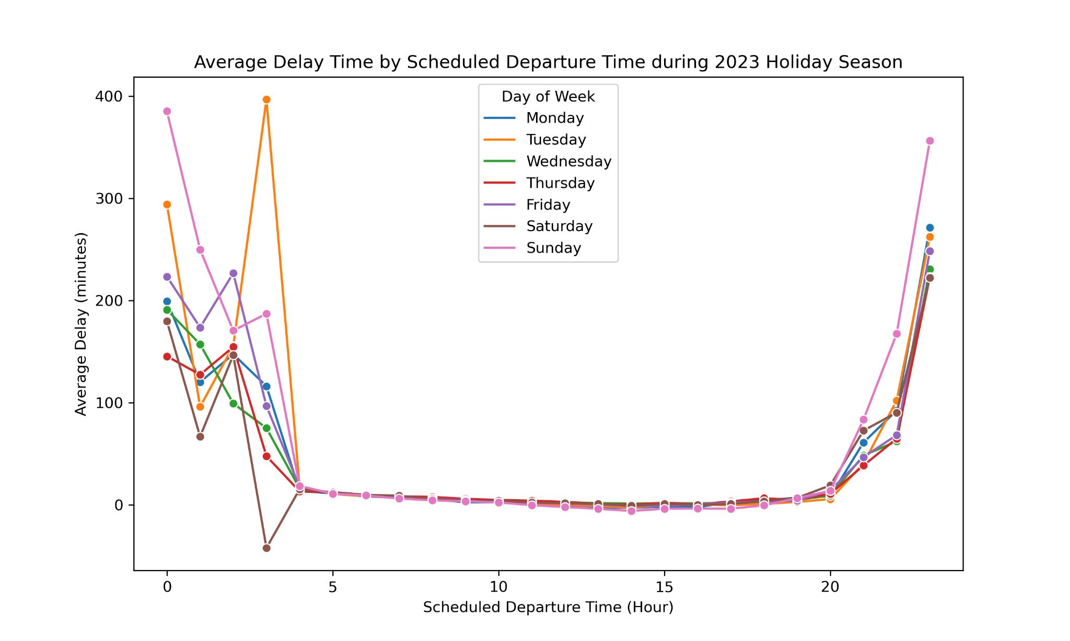
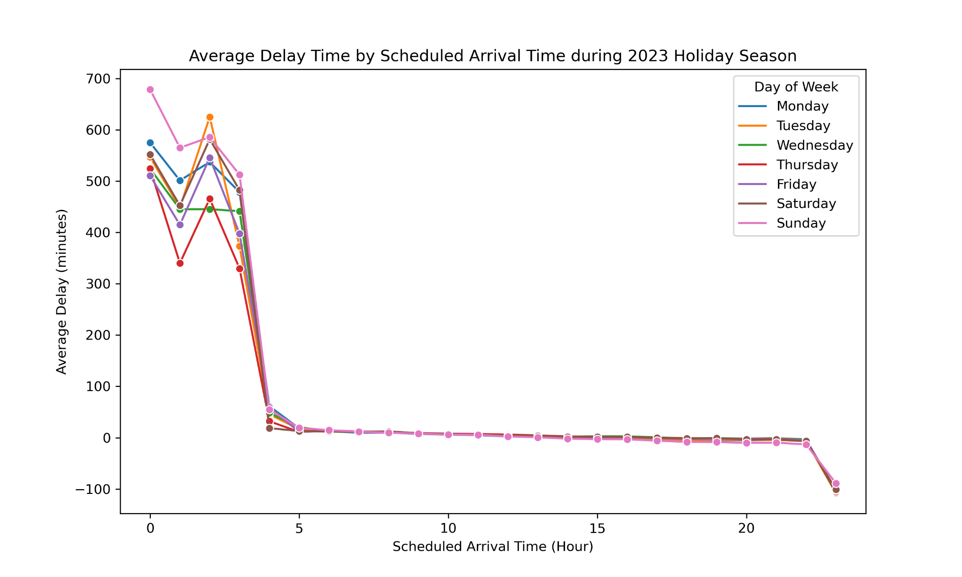
02 EDA
Different days of the week tend to show similar patterns across time periods (morning, afternoon, evening, night). So we transformed the scheduled arrival and departure times to better account for these patterns.

Slide 10
03
Final Model

Slide 11
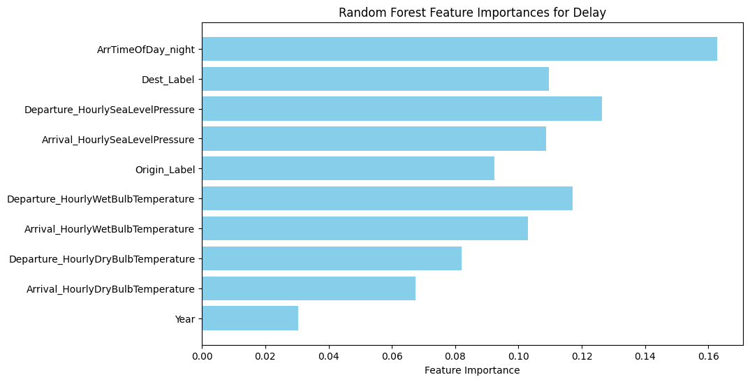
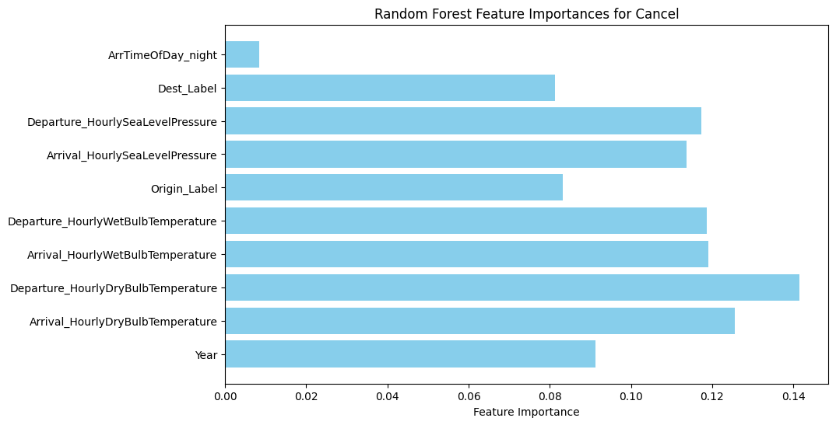
03 Variable selection
Select 9 predictor from 29 available predictor
First, we built a Random Forest model using all available predictors from raw data.
Then, we selected 9 predictors that were important in both the delay time prediction model and the cancellation prediction model, and used them to fit the final model on the training data.

Slide 12
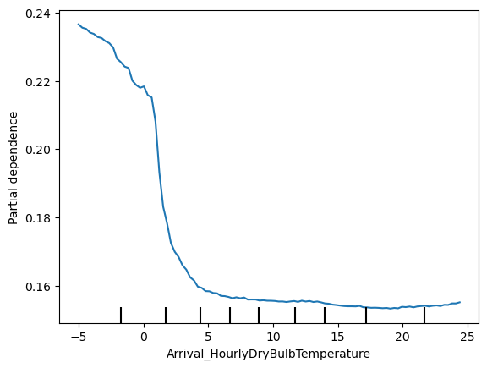
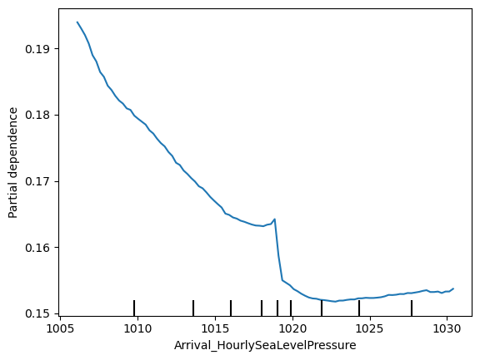
03 Final model
Fitting Final Model:
We use partial dependence plots to determine the effect direction of the predictors.
Here, we present two predictors for the cancellation prediction model.

Slide 13
04
Conclusion

Slide 14

04 Conclusion
Final Model:
We developed two Random Forest models to predict flight delay times and cancellation probabilities, achieving reasonable accuracy and identifying key predictors like nighttime arrivals and weather conditions (temperature and pressure).
Strengths:
1. High Accuracy for Non-Canceled Flights: The Random Forest classifier achieved 83% accuracy with strong precision (99%) for identifying non-canceled flights.
2. Effective Feature Identification: Key predictors like nighttime arrival and weather conditions were highlighted, offering insights on delay and cancellation risks.
3. Reduced Overfitting: Compared to single decision trees.
Weakness:
Our model is complex and has lower performance for canceled flight prediction due to the sample imbalance.
Shiny App: https://stat628module3.shinyapps.io/apppy/

Slide 15
Thank you for listening!

